Slide 1
Time Series
ARIMA Modeling

Slide 2
Regression
Basic Concepts (acf, pacf, AR, MA)
ARMA Model
Industry Applications
ARIMA Model
Copyright © 2016 Defour Analytics Pvt. Ltd

Slide 3
Some basic concepts
Two basic types of time series models exist,
Autoregressive
Moving average models.
So, what’s the big difference?
The AR model includes lagged terms of the time series itself.
The MA model includes lagged terms on the noise or residuals.
How do we decide which to use?
ACF and PACF

Slide 4
acf, pacf, AR, MA
The autocorrelation function (ACF) is a set of correlation coefficients between the series and lags of itself over time.
The partial autocorrelation function (PACF) is the partial correlation coefficients between the series and lags of itself over time.
An autoregressive model of order “p” AR(p)
X _{t} = β₁ X _{t −1} + β₂ X _{t −2} + ... + β _{p} X _{t − p} + e_{t}
Current value of X_{t} can be found from past values, plus a random shock e_{t}
Like a multiple regression model, but X_{t} is regressed on past values of X_{t}
A moving-average model of order “q” MA(q)
X _{t} = e_{t} + β₁e_{t −1} + β₂e_{t −2} + ... + β_{q} e_{t −q}
Current value of X_{t} can be found from past shocks/error (e), plus a new shock/error (e_{t}).
The time series is regarded as a moving average (unevenly weighted, because of different coefficients) of a random shock series e_{t} .

Slide 5
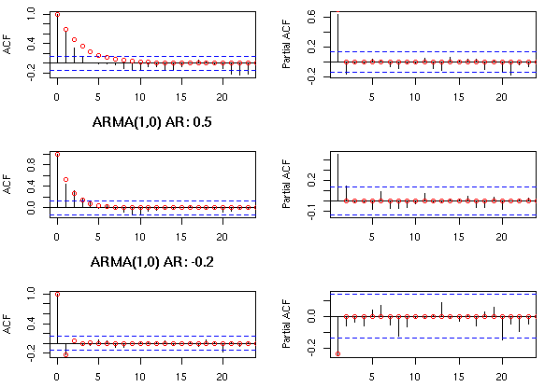
Identifying an AR process
The autocorrelations of a pure AR(p) process should decay gradually at increasing lag length. Hence, using an autocorrelogram it is not possible to differentiate between a pure AR(3) model or a pure AR(4) model. However, the partial autocorrelations of a pure AR(p) process do display distinctive features. The partial autocorrelogram should ‘die out’ after p lags. Thus, the partial autocorrelogram of a pure AR(3) process should die out after 3 lags, whereas that of a pure AR(4) process would die out after 4 lags.
ACF and PACF for an AR(1) process

Slide 6
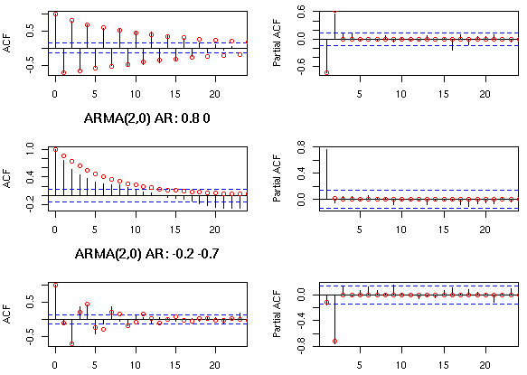
ACF and PACF for an AR(2) process

Slide 7
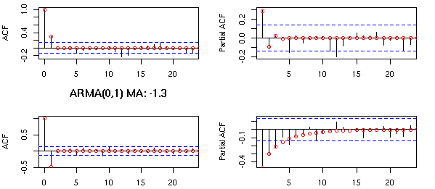
Identifying a MA process
The behaviour of correlograms and partial autocorrelograms for pure MA(q) processes is the reverse of that for pure AR processes. The autocorrelogram of a pure MA(q) process should ‘die out’ after q lags. The partial autocorrelogram of a pure MA process, on the other hand, only decays slowly over time (similar to the behaviour of the autocorrelogram of a pure AR process). Thus, it should be impossible to distinguish between the PACF of an MA(3) and MA(4) process, whereas the ACF of the MA(3) process should decay to zero after 3 lags and the MA(4) process after 4 lags.
ACF and PACF for an MA(1) process

Slide 8
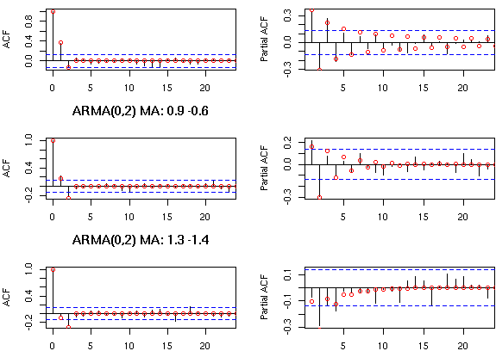
Identifying a MA process (contd…)
ACF and PACF for an MA(2) process

Slide 9
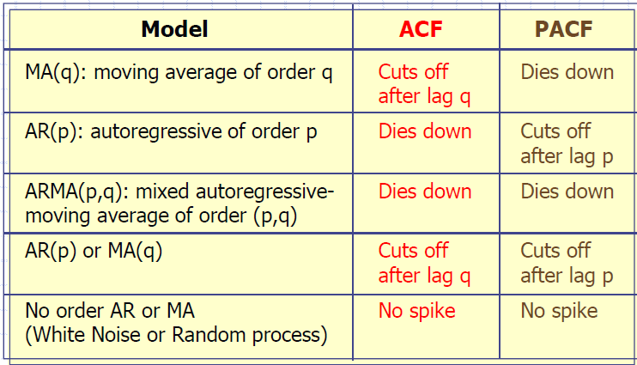
General Theoretical ACF and PACF of ARIMA Models

Slide 10
ARMA models
ARMA models are only suited for time series stationary in mean and variance
A mixture of these two types of model would be referred to as an autoregressive moving average model (ARMA)n,q, where n is the order of the autoregressive part and q is the order of the moving average term.
Mixed ARMA models "An ARMA process of the order (p, q)"
X _{t} = β₁X_{t −1} + ... + β _{p} X_{t − p} + α₁e_{t −1} + α₂e_{t −2} + ... + α_{q} e_{t −q}
Just a combination of MA and AR terms.
Sometimes you can use lower-order models by combining MA and AR terms.
Lower order models are better.

Slide 11
How do we choose the best ARMA model?
In most cases, the best model turns out a model that uses either only AR terms or only MA terms.
It is possible for an AR term and an MA term to cancel each other’s effects, even though both may appear significant in the model.
If a mixed ARMA model seems to fit the data, also try a model with one fewer AR term and one fewer MA term.
As with OLS, simpler models are better.

Slide 12
ARIMA Model
"Type of ARMA model that can be used with some kinds of non-stationary data“
"Useful for series with stochastic trends. First order or “simple” differencing“
Series with deterministic trends should be differenced first then an ARMA model applied
"The “I” in ARIMA stands for integrated, which basically means you’re differencing"
ARIMA is also known as Box-Jenkins approach. It is popular because of its generality; It can handle any series, with or without seasonal elements, and it has well-documented computer programs

Slide 13
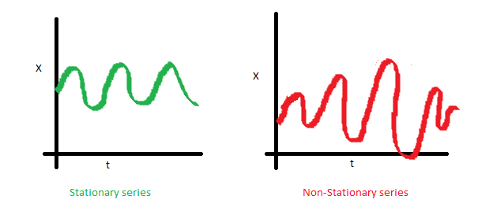
ARIMA MODEL
A non seasonal ARIMA model is classified as an "ARIMA(p,d,q)" model, where:
p is the number of autoregressive terms,
d is the number of non seasonal differences needed for stationarity, and
q is the number of lagged forecast errors in the prediction equation.
e.g. ARIMA(1,1,0) is a first-order AR model with one order of differencing
Stationary Series: A stationary series has no trend, its variations around its mean have a constant amplitude. A non stationary series is made stationary by differencing

Slide 14
Stationarity check and determination of d
If the process is non-stationary then first differences of the series are computed to determine if that operation results in a stationary series.
The process is continued until a stationary time series is found.
This then determines the value of d.

Slide 15
Determination of the values of p and q
To determine the value of p and q we use the graphical properties of the autocorrelation function and the partial autocorrelation function.
Again recall the following:

Slide 16
Which ARIMA(p,d,q) model do I use?
Plot the data.
Look to see if the data is stationary, that is they are scattered randomly about a constant mean level. Also look at the ACF and PACF (stationarity is implied by the ACF or PACF dropping quickly to zero).
If there is non-stationarity, such as a trend (we’re ignoring seasonal behavior for the moment!), difference he data. Practically, at most two differences need to be taken to reduce a series to stationary. Verify stationarity by plotting the differenced series and looking at the ACF and PACF.
Once stationary is obtained, look at the ACF and PACF to see if there is any remaining pattern. Check against the theoretical behavior of the MA and AR models to see if they fit. This will give you an ARIMA model with either no MA or no AR component i.e. ARIMA(0,d,q) or ARIMA(p,d,0).
If there is no clear MA or AR model, an ARMA model will have to be considered. These can in general not be guessed from the ACF and PACF, other methods are needed, based on the ideas of minimizing Information Criterion (AIC or BIC).

Slide 17
Seasonal ARIMA Model
ARIMA models cannot really cope with seasonal behavior. Hence we introduce seasonal ARMA model denoted by ARMA (P,Q)h. Seasonal ARMA can be of two types-
Seasonal ARMA (ARMA (p,q)) – Only seasonal components
Mixed seasonal ARMA (ARMA(p,q)(p,q)s. Combination of normal ARMA and seasonal ARMA.
In case trend and seasonality both are present. We will use ARIMA model instead of ARMA. The idea behind the seasonal ARIMA is to look at what are the best explanatory variables to model a seasonal pattern.
You can use ACF and PACF to identify P or Q:
For ARIMA(0, 0, 0)(P, 0,0)s , you should see major peaks on the PACF at s, 2s, ....Ps. On the ACF, the coefficients at lags s, 2s, ....Ps, ... should form an exponential decrease, or a damped sine wave.
ARIMA(0, 0,0)(0,0,Q)s , you should see major peaks on the ACF at s, 2s, ....Qs. On the PACF, the coefficients at lags s, 2s, ....Qs,... should form an exponential decrease, or a damped sine wave.
Using the AIC as the selection criterion, we select the ARIMA model with the lowest value of the AIC.

Slide 18
The Box-Jenkins model building process
Box and Jenkins (1976) proposed a modelling strategy for pure time series forecasting
Model identification
Autocorrelations
Partial-autocorrelations
Model estimation
The objective is to minimize the sum of squares of errors. Fitting many different possible models and using a goodness of fit statistic (AIC) to select “best” model
Model validation
Certain diagnostics are used to check the validity of the model
Examine residuals, statistical significance of coefficients.
Two methods:
Examine residuals
AIC or SBC
Model forecasting
The estimated model is used to generate forecasts and confidence limits of the forecasts
AIC- The Akaike Information Criterion is a function to determine the best model. Lower the AIC is better the model

Slide 19
Industry related examples
Production and Utilization of Gas.
Natural gas prices.
Estimation and Forecast of the Models for Stock Market Performance of the Oil & Gas Companies.
Oil Sales forecasting using ARIMA models.
Modelling and forecasting future values for monthly crude oil exportation.
Operation parameters.

Slide 20
Steps for ARIMA MODEL
Visualization
ACF and PCF plot
Seasonal variation modelling
Stationary check
Identifying p,d,q for non seasonal series
Model development
Validating accuracy
Selecting best model

Slide 21
Energy Meter
An electric meter is a device that measures the amount of electric energy consumed by a residence, a business or electrically powered devices.
Electric utilities install meter at the customer premises to measure electric energy delivered to their customers for billing purpose.
They are calibrated in billing units and the most popular and accepted unit is measured in kilo watt hour (KWH).

Slide 22
Types of energy meter
It is classified in accordance with several factors such as
Types of display - Analog or digital
Type of metering point – Grid, primary / secondary transmission and local distribution.
End applications - Domestic, commercial industrial
Technical application – 3 phase, single phase, LT, HT and accuracy class meter.

Slide 23
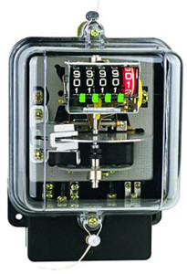
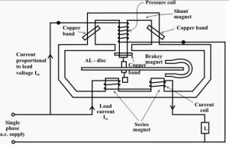
Energy Meter

Slide 24
Problem statement.
Our objective is to : -
To find clusters of high, low, medium consumers on daily basis. (weekdays / weekends)
To forecast what is going to be consumption for next 7 days and/or next month.
What should be the demand forecast? (Identify the shortage day and provide back up)
Identify spike. (outlier detection)
Able to satisfy the demand.

Slide 25
R Script (Weekly forecast of a meter)
setwd("C://R")
md20=read.csv("md20.csv")
View(md20)
md20=ts(md20,start=2012,frequency = 7)
md720=md20[,-c(1)]
View(md720)
plot(md720)
acf(md720)
pacf(md720)
plot(md720)
acf(md720)
pacf(md720)
plot(diff(md720))
plot(diff(diff(md720)))
library(forecast)
ARIMAfit=auto.arima(md720)
summary(ARIMAfit)
md720.pred=predict(ARIMAfit,n.ahead=7)
md720.pred

Slide 26
R Script (Weekly forecast of a meter)
setwd("C://R")
md20=read.csv("md20.csv")
View(md20)
md=ts(md20,start=2012,frequency = 7)
md1=md[,-c(1)]
plot(md1)
library(forecast)
ARIMAfit=auto.arima(md1)
x=forecast(ARIMAfit,8)
plot(x)

Slide 27
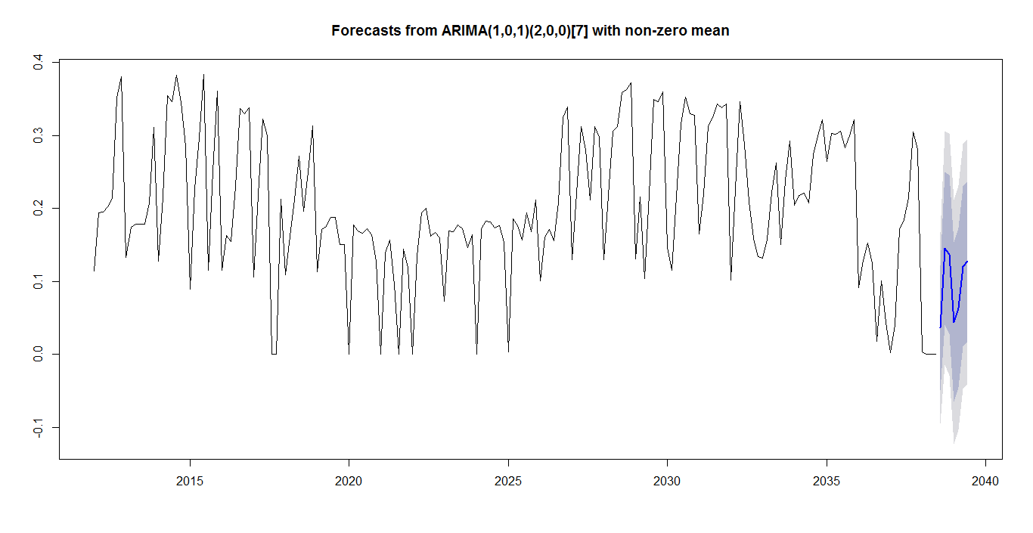
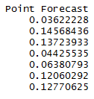
Graphs (Weekly)

Slide 28
R Script (Monthly forecast of a Meter)
setwd("C://R")
tmd=read.csv("Trymd.csv")
View(tmd)
tail(tmd)
tmd=ts(tmd,start=2012,frequency = 12)
tmd1=tmd[,-c(1)]
View(tmd1)
plot(tmd1)
acf(tmd1)
pacf(tmd1)
plot(diff(tmd1))
plot(diff(diff(tmd1)))
plot(diff(diff(diff(tmd1))))
plot(diff(diff(diff(diff(tmd1)))))
plot(diff(diff(diff(diff(diff(tmd1))))))
library(forecast)
ARIMAfit=auto.arima(tmd1)
summary(ARIMAfit)
tmd1.pred=predict(ARIMAfit,n.ahead=6)
tmd1.pred

Slide 29
R Script (Monthly forecast of a Meter)
setwd("C://R")
tmd=read.csv("Trymd.csv")
View(tmd)
md=ts(tmd,start=2012,frequency = 12)
md1=md[,-c(1)]
plot(md1)
library(forecast)
ARIMAfit=auto.arima(md1)
x=forecast(ARIMAfit,12)
plot(x)

Slide 30
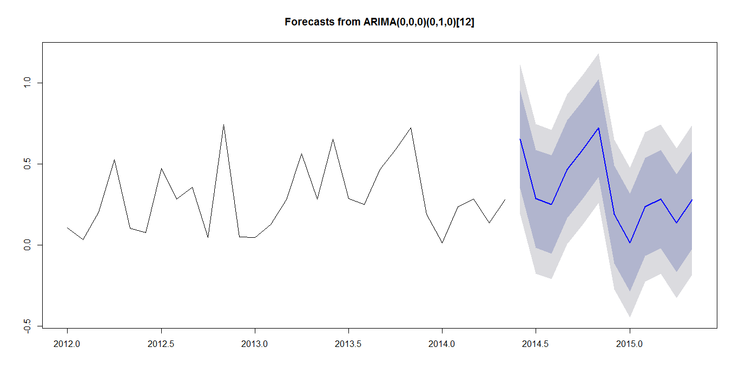
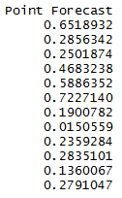
Graph (Monthly)

Slide 31
Concluding Statement

Slide 32
Design Thinking
Ask the participants what kind of problems related to their industry can be solved using this concept.

Slide 33
Question & Answers

Slide 34
THANK YOU
Copyright © 2016 Defour Analytics Pvt. Ltd

